Slide 1
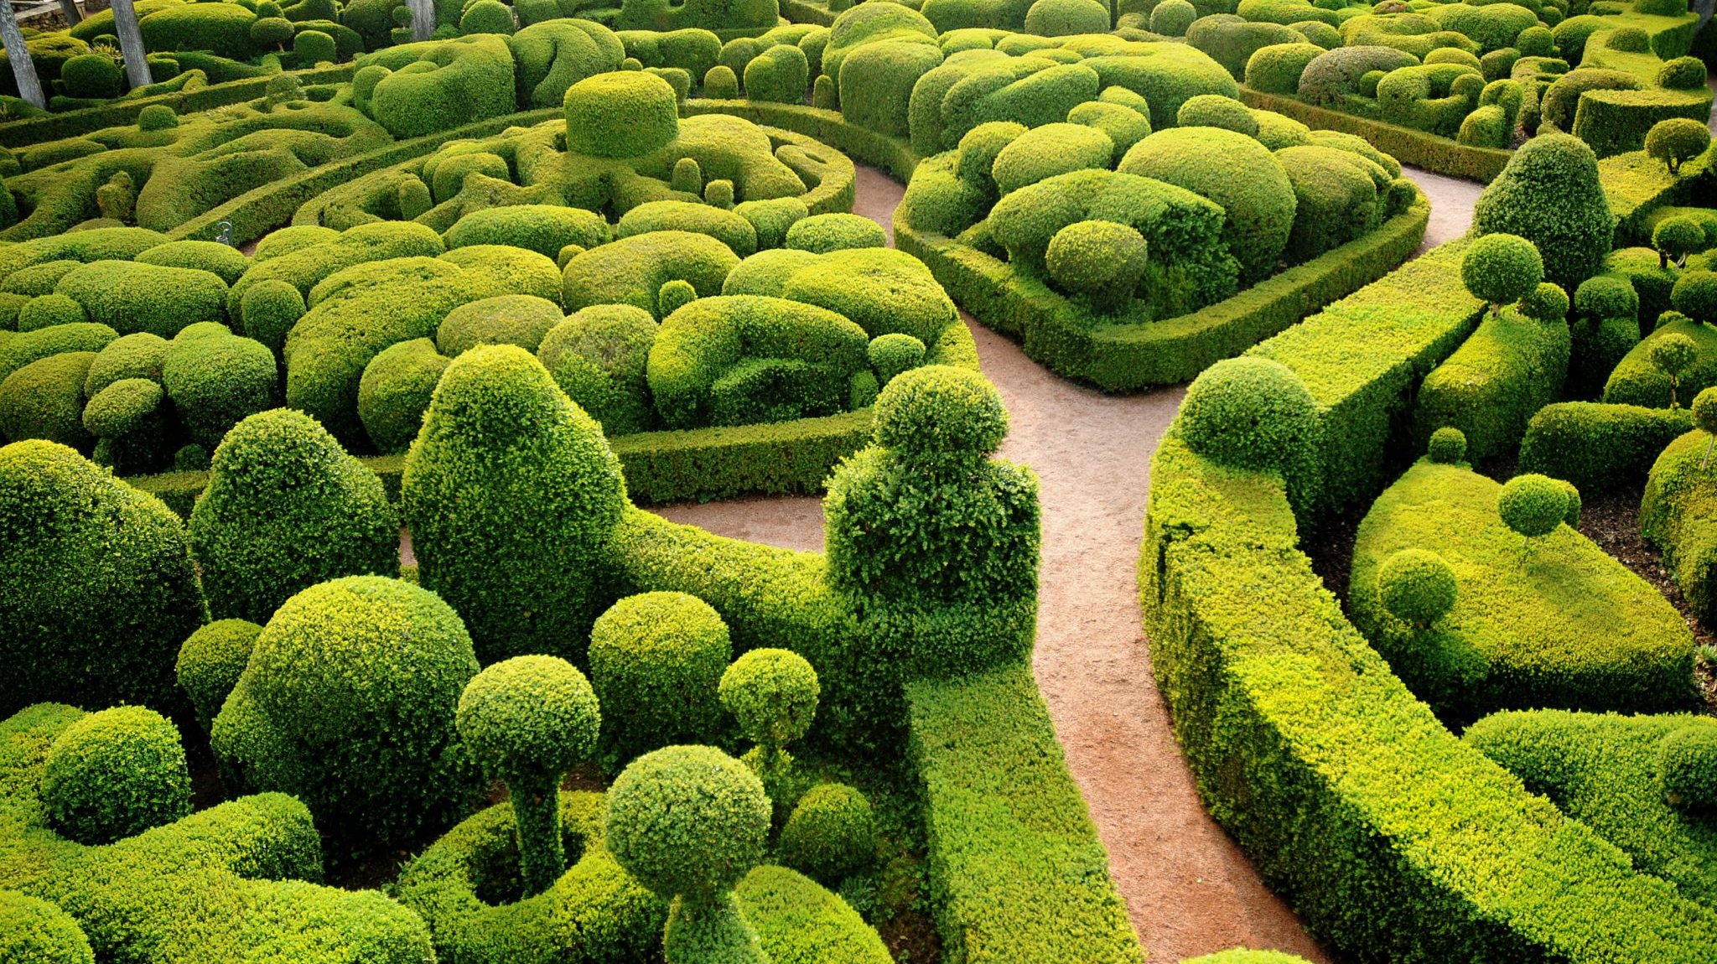
STEM Garden
Inesh Dey, Avinish Dighe, Jeff Gao, Chloe B, Alexander Peev, Koji H, Theo P

Slide 2
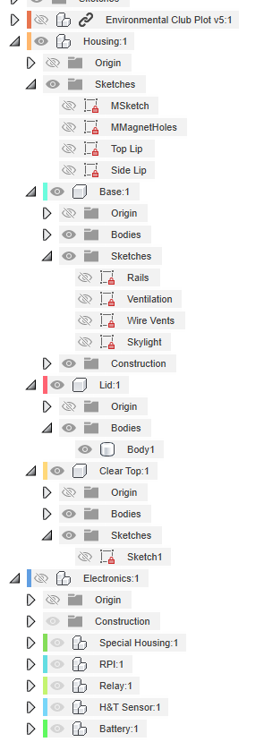
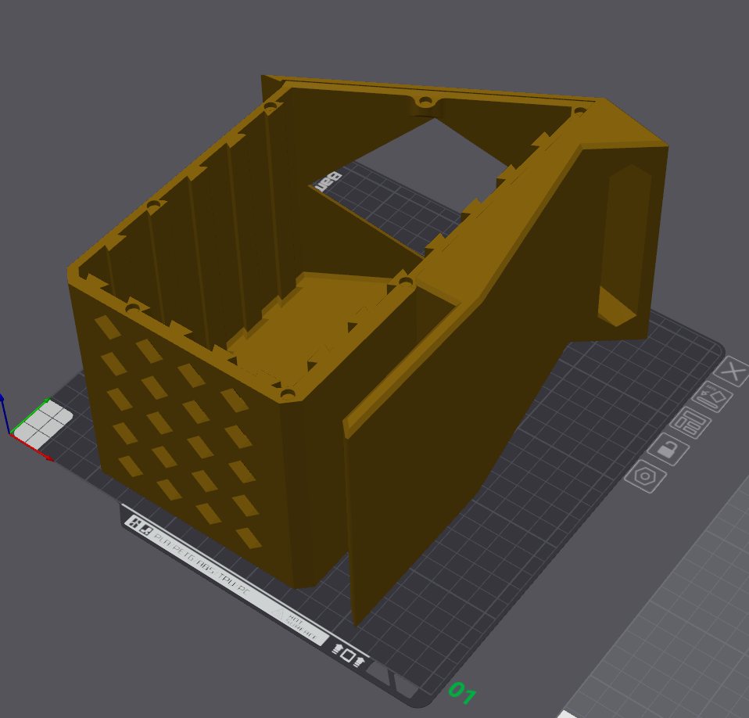
Structure – CAD and Assembly
Fusion File
Labeled and easy to edit for beginners
Slicing and printing
No supports needed
Additions
Glue on meshing for holes
Full assembly
Components attaches to sleds that go into the rails
Glue on 6mm x 3mm neodymium magnets
Spacers to hold them in place
Designed for 3D printing

Slide 3
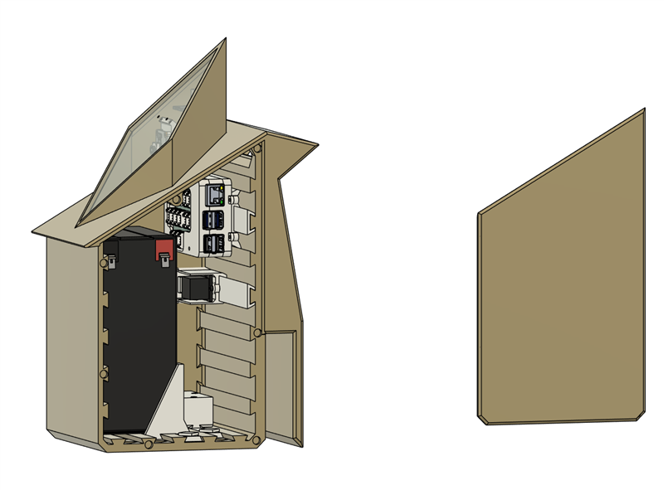
Structure - Challenges:
Modularity
Able to incorporate various features
Longevity
Made of ASA
Features netting around holes to prevent infestation
Accessibility
Easy to maintain components
Simplicity
Minimal assembly needed
Anyone can create more with their 3d printer
Easy addition and removal of features
Ample amounts of space

Slide 4
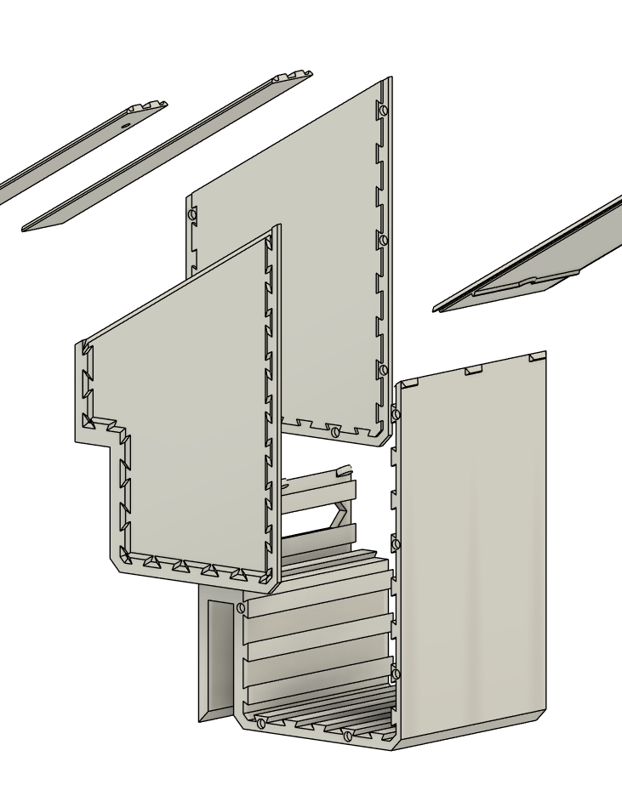
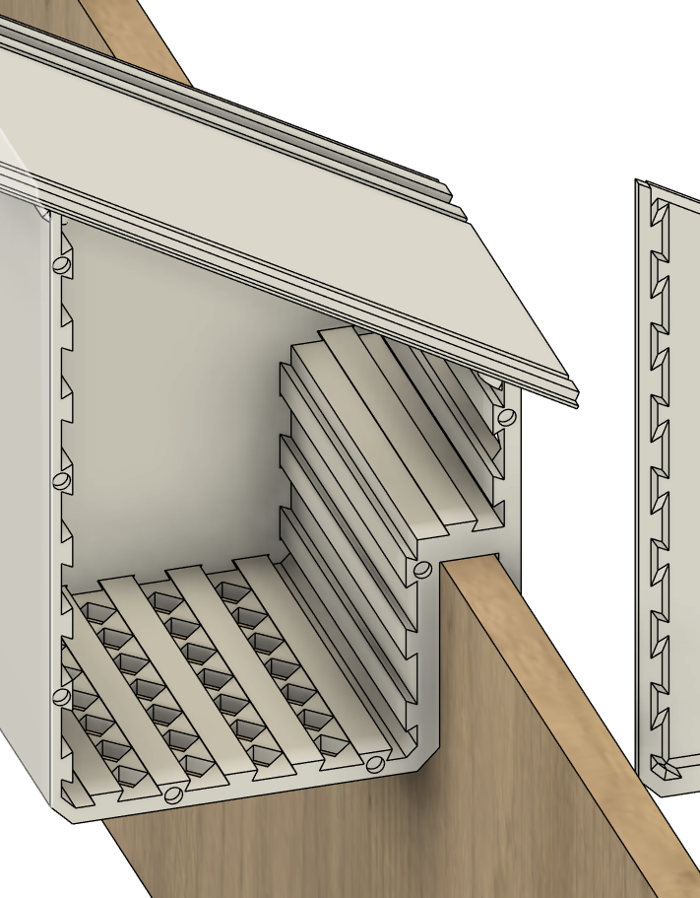
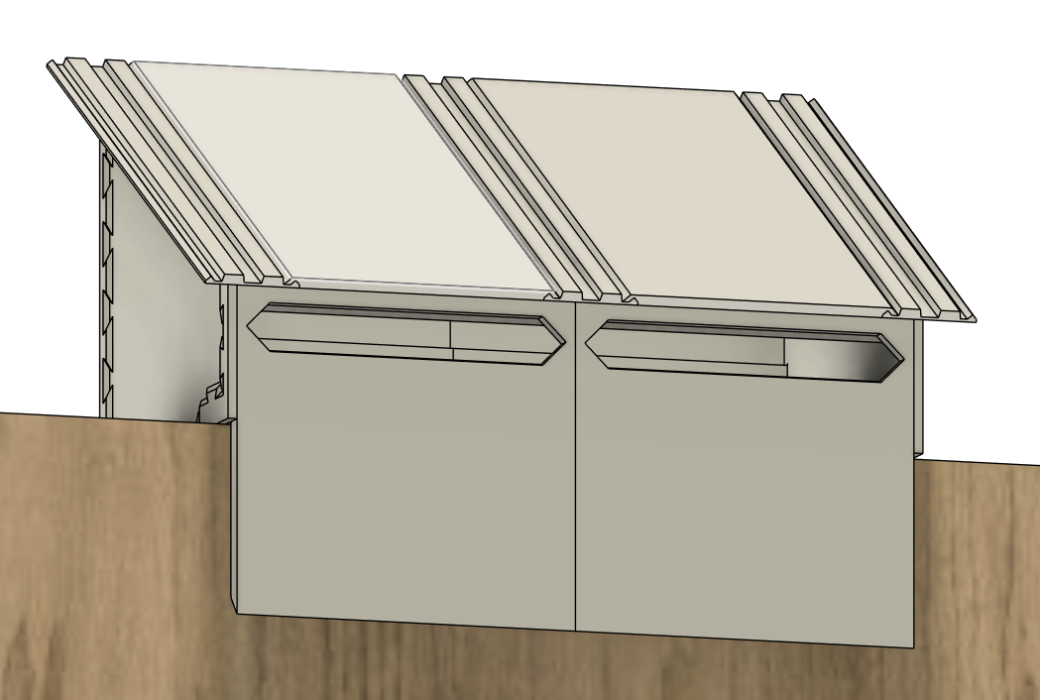
Structure – Future V2 (Jeff was bored)
Fully expandable (you can chain them together)
Better space optimizations
Same rail system as before
Better roof slanting
Optimized sensor readings

Slide 5
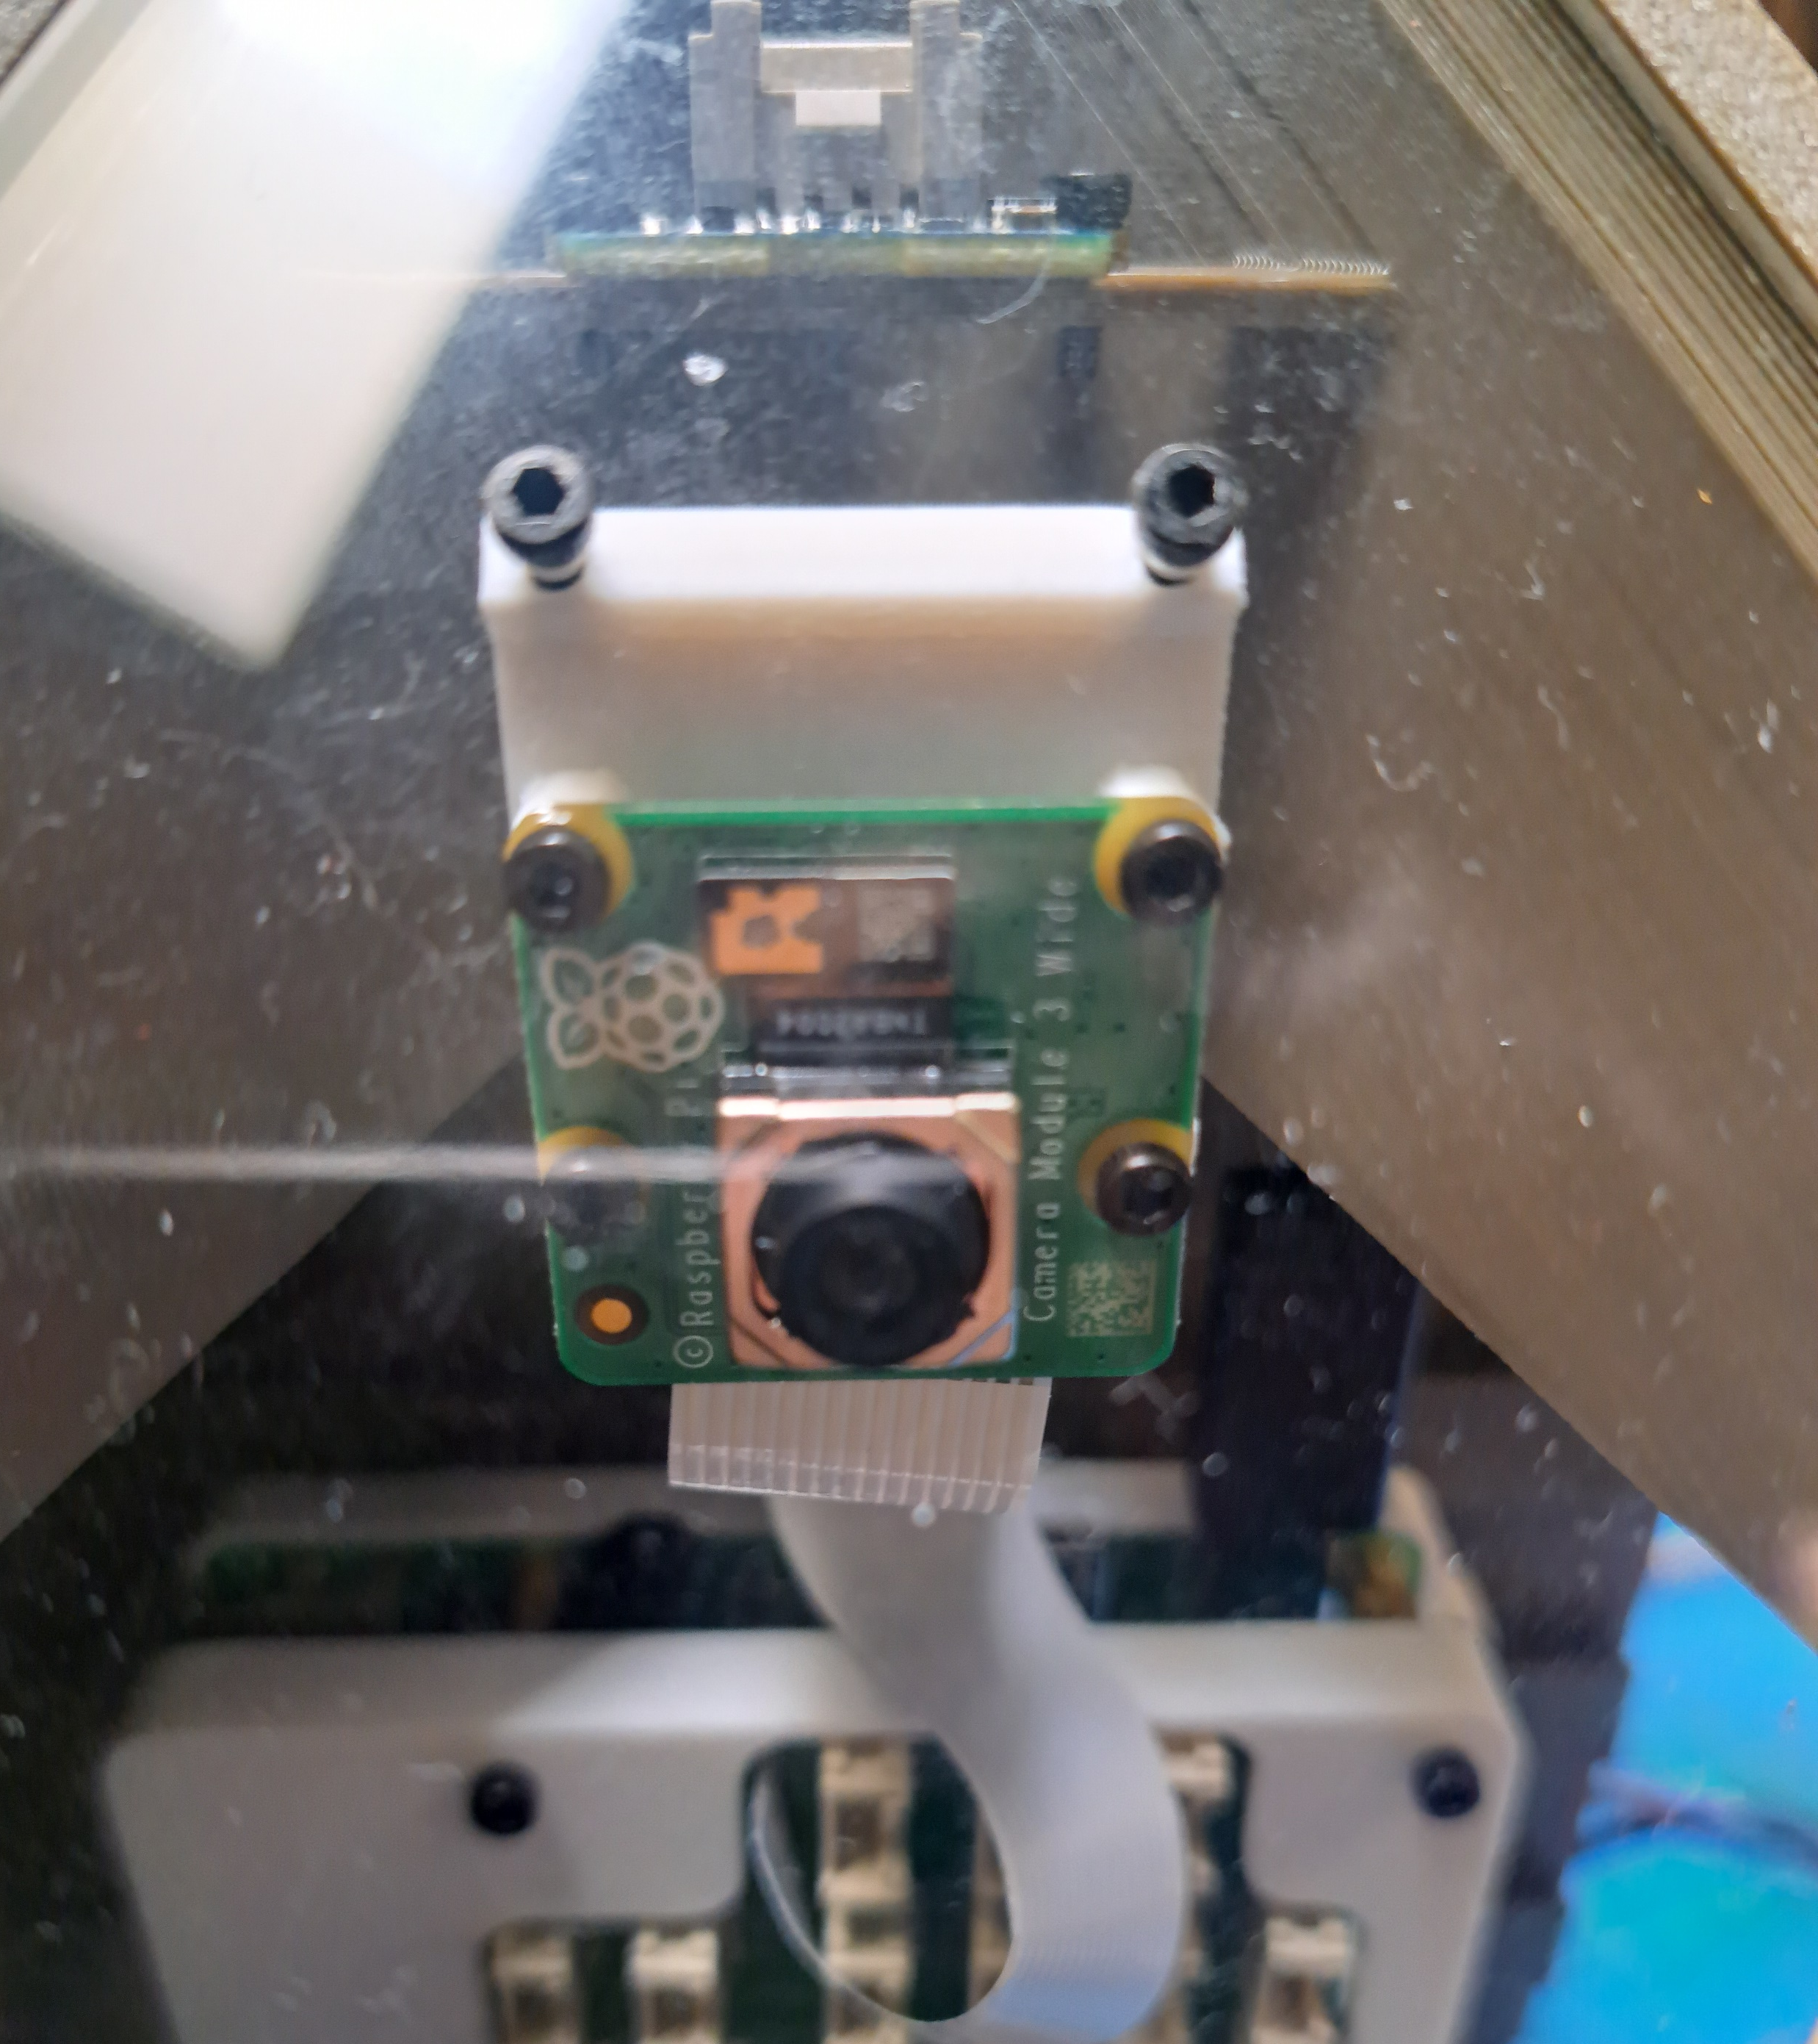
Programming - Sensors
9 Sensors, 1 Raspberry Pi
Environmental sensors assess garden conditions
Camera gives view of garden
Water pump turns on when soil moisture sensors detect too low of a moisture, initiates irrigation
Raspberry Pi codebase hosted on GitHub

Slide 6
Programming - Website
Raspberry Pi posts freely accessible data on our website.

Slide 7
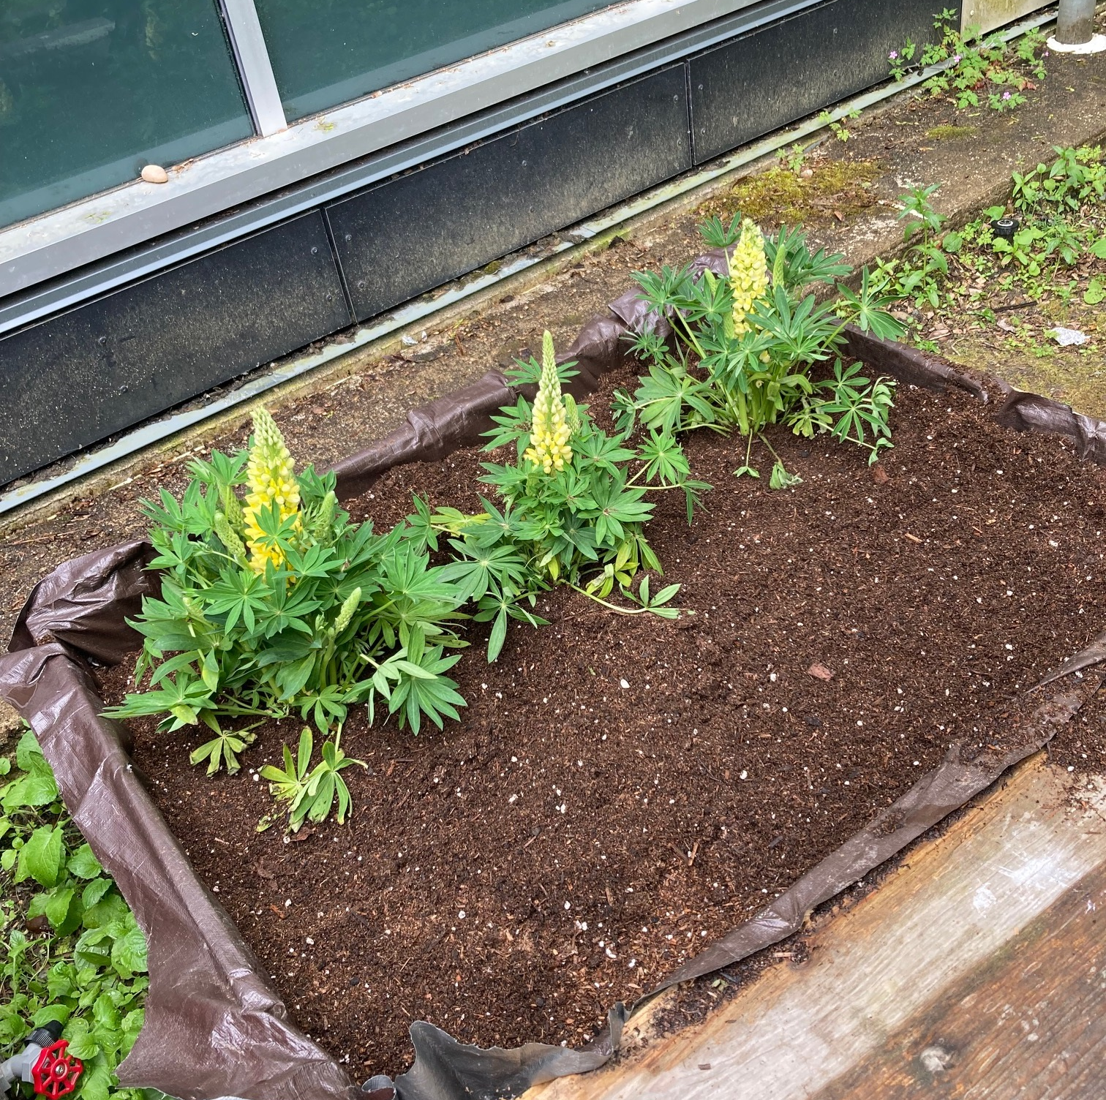
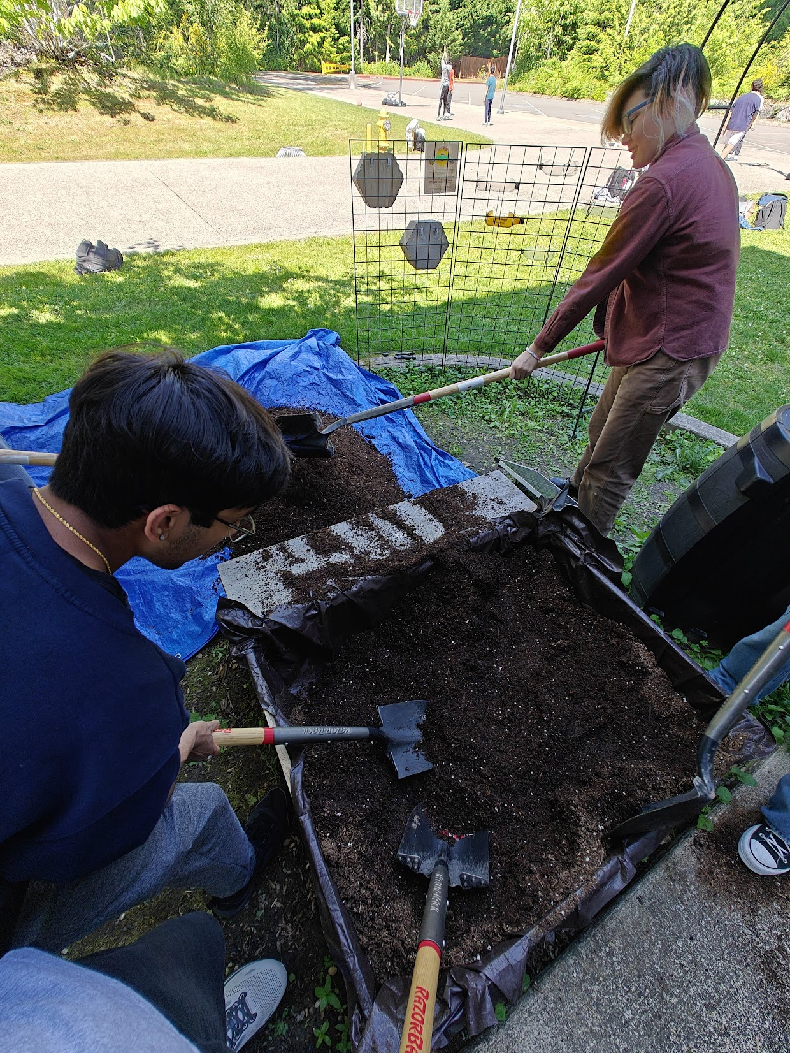
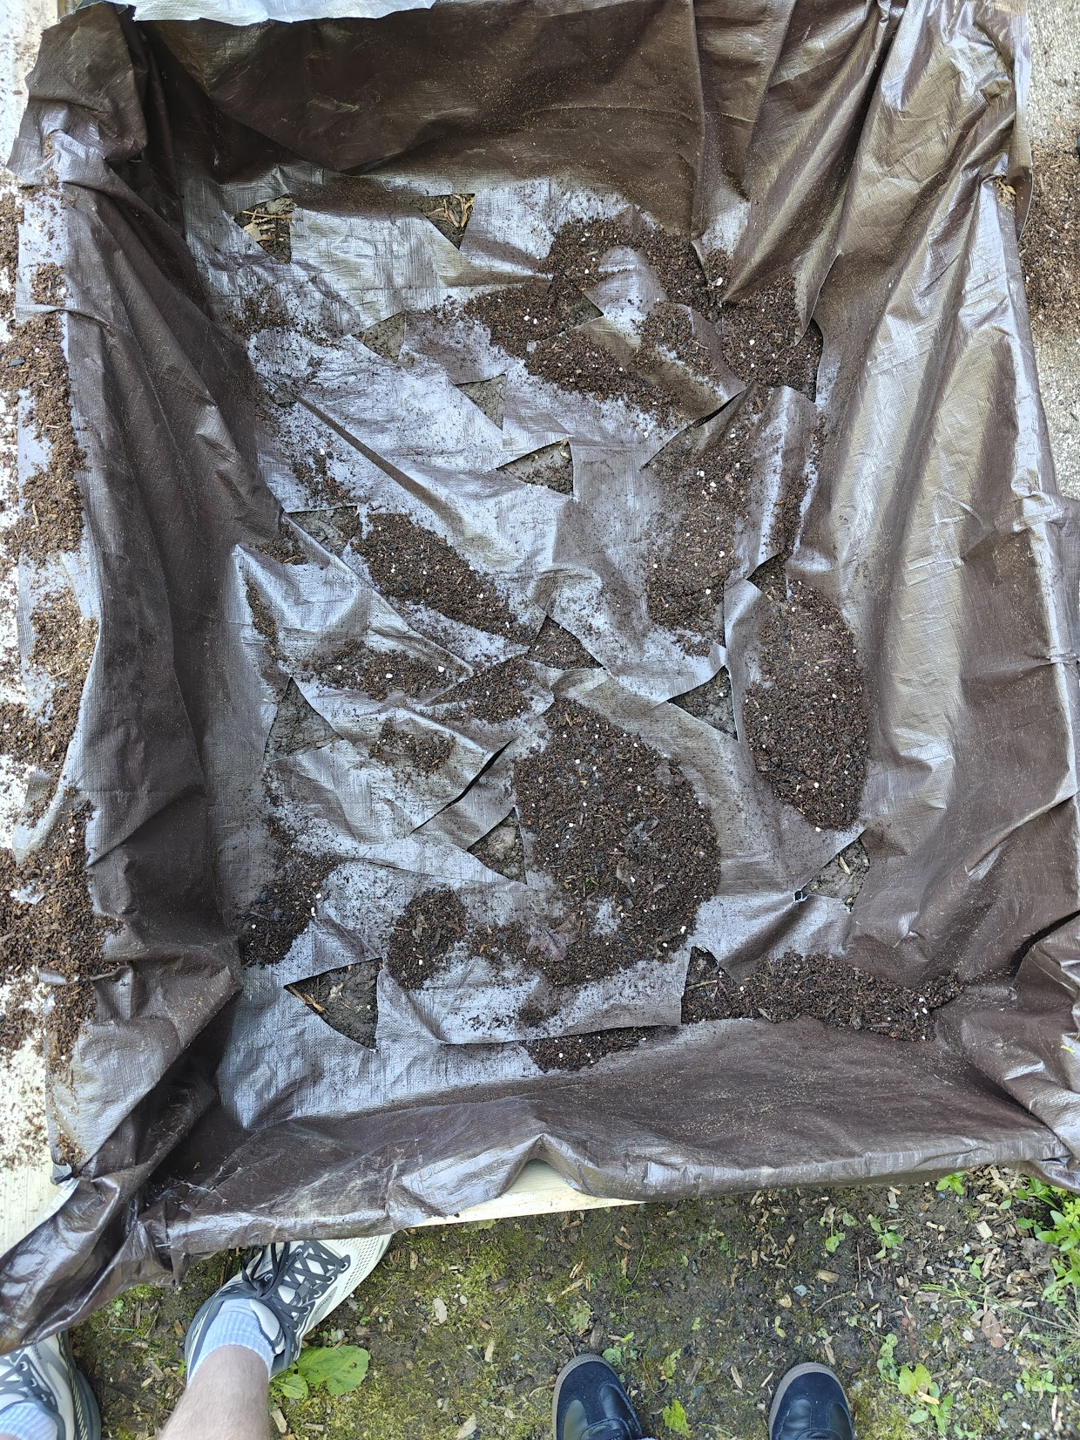
Garden Bed
Slits in bottom for drainage
Prevents mold/ over watering
Contains 6 plants (all native)
More on next slide
Soil Type: Woodland Garden Mix
Mimics soil form forest floor
Native to PNW
Best for native plants

Slide 8
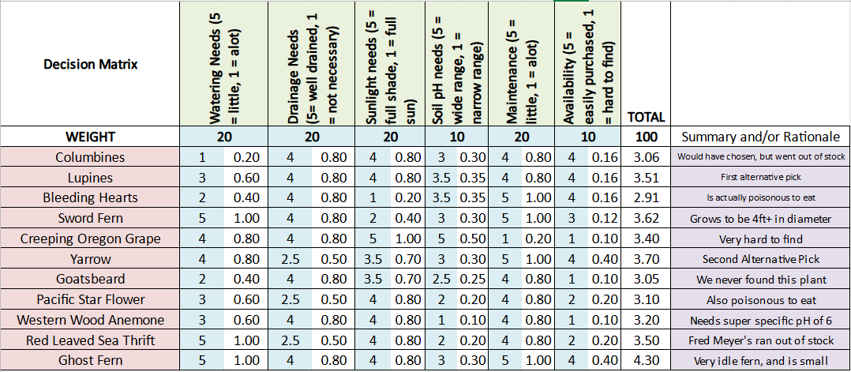
Plants

Slide 9
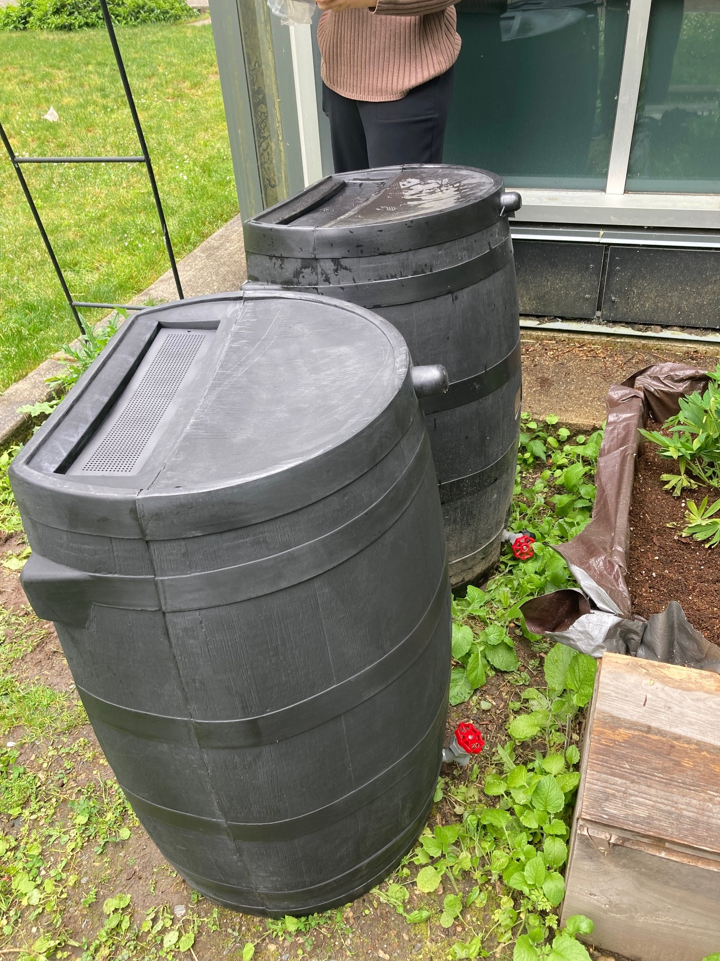
Rain Barrel
Pump housed inside barrel
Water piped out and irrigated into plants
Recaptures grey water
Stores water (50 gal capacity each)

Slide 10
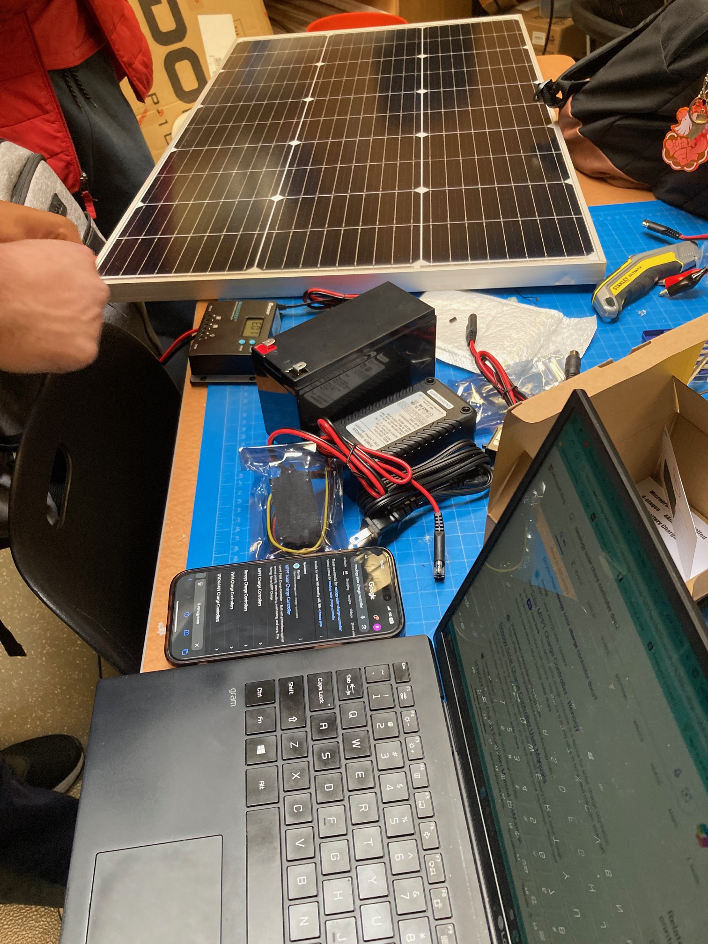
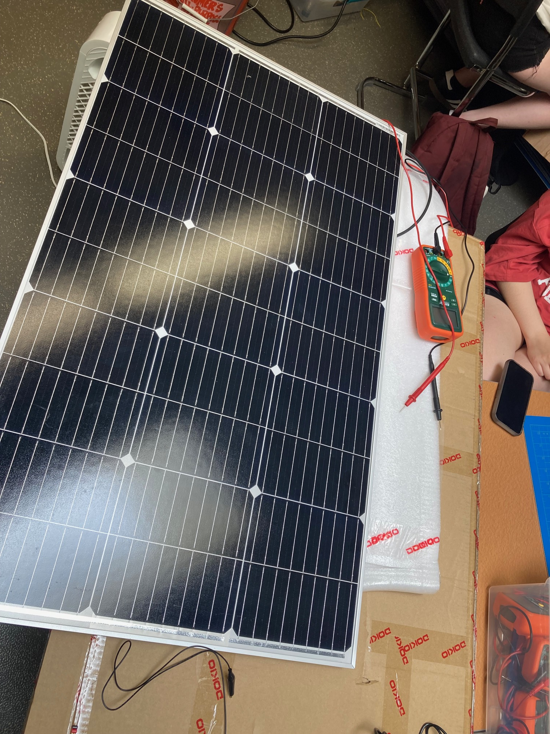
Solar Power

Slide 11
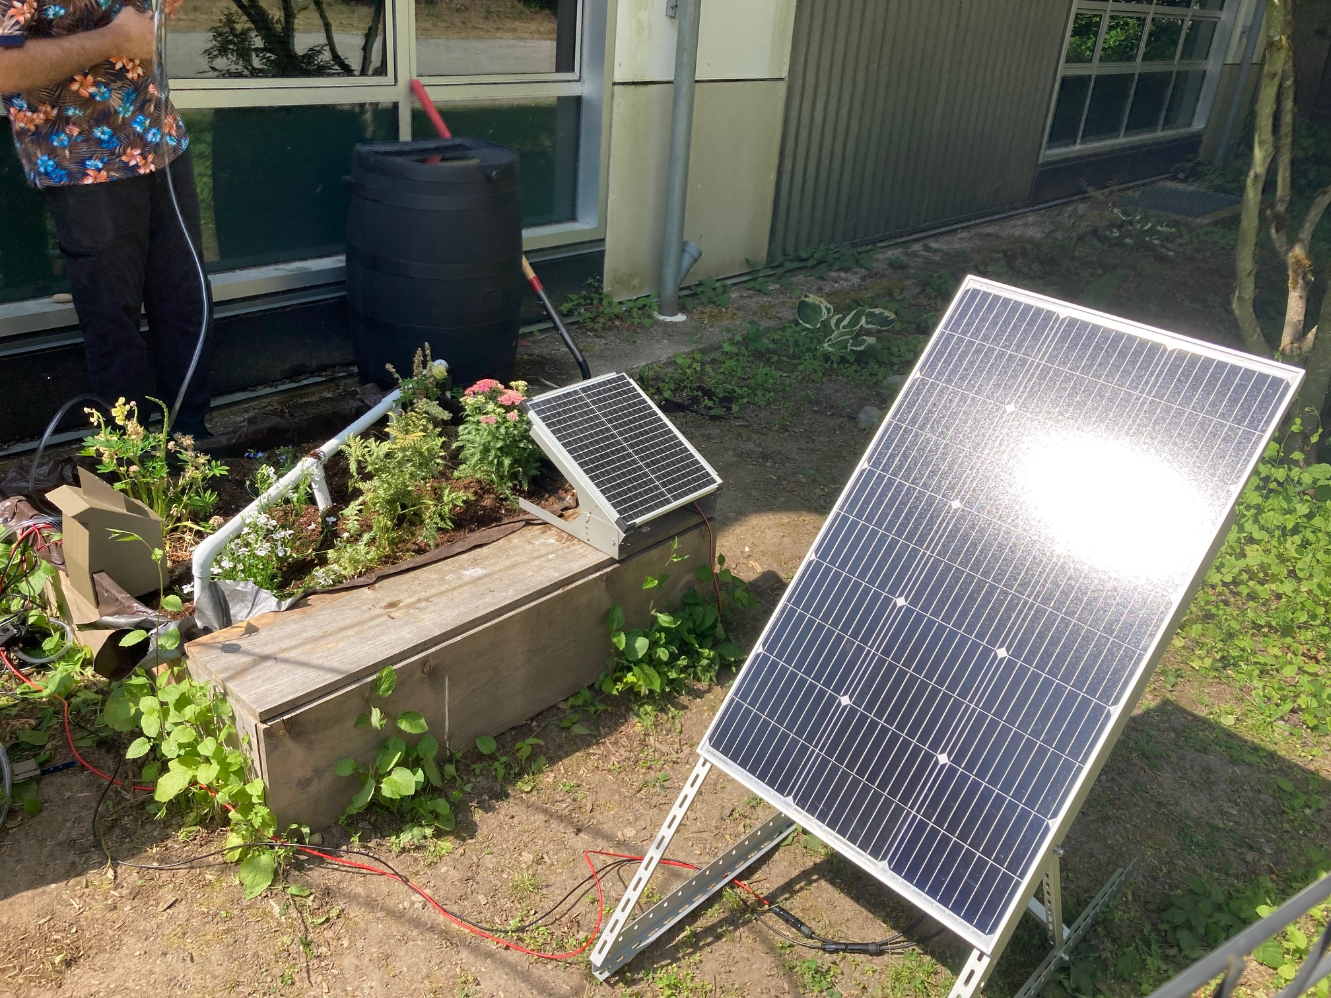
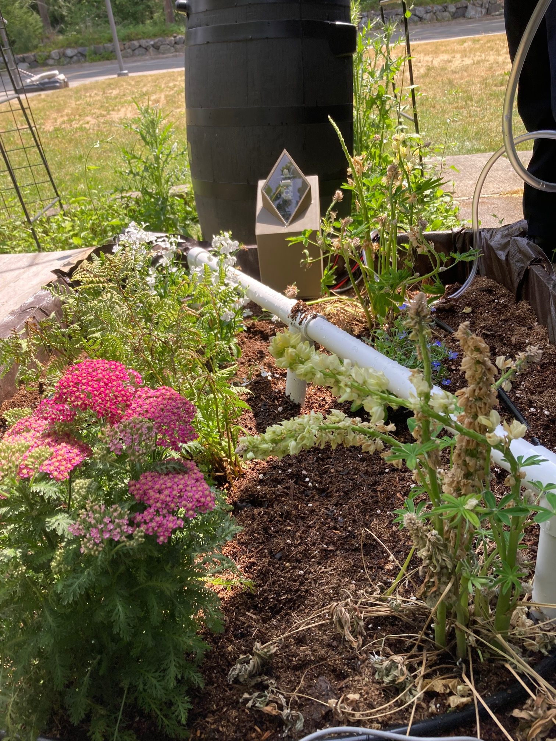
Final Product
2 Lupines, 1 Yarrow, 2 ghost fern, 2 Lobelias

Slide 12




Legacy Plan
Establish a closed loop water flow so any extra water can return to the water barrel, and methods of controlling shade
Pass the project on to next year’s primarily Environmental Club, Engineering Club possibly, and EESD students

